Slide 1

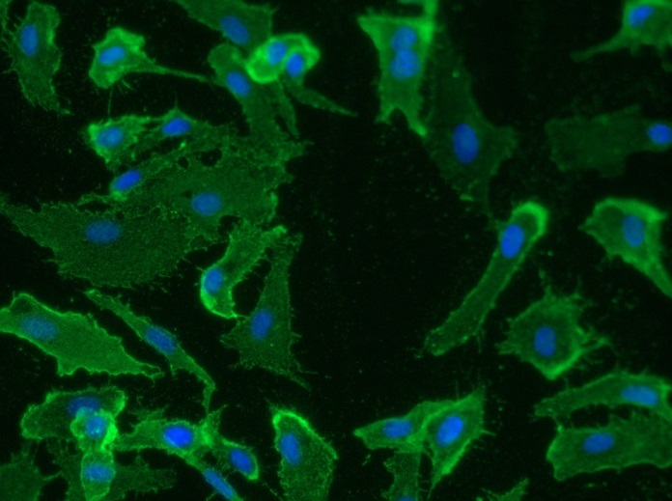
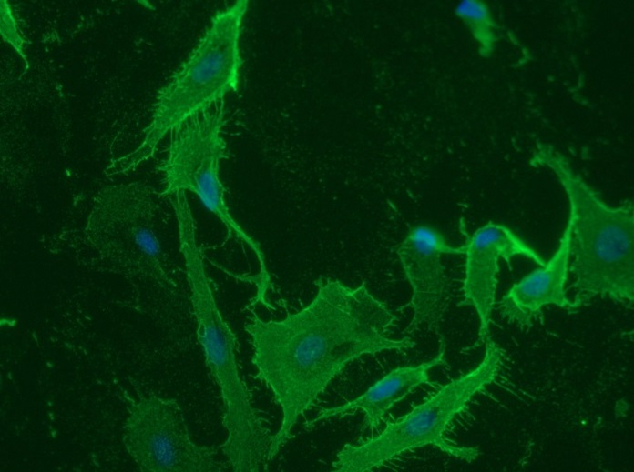
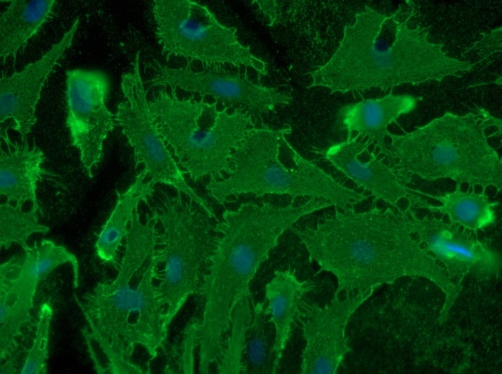
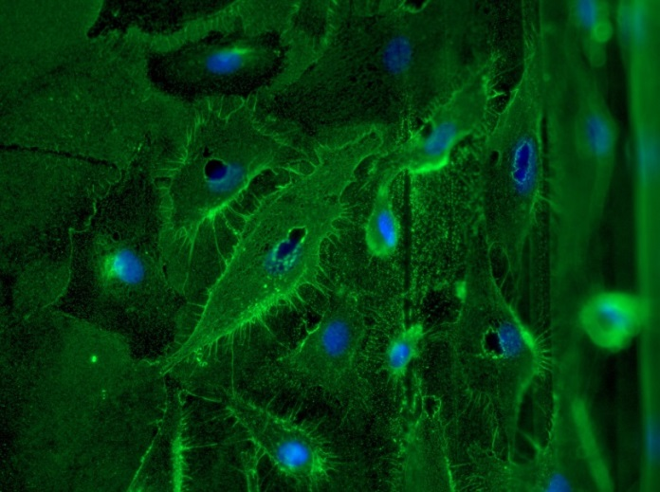
Reliatech GmbH
Mouse anti-human Podoplanin
(Cat# 101-M40)
Immunofluorescence staining of human Podoplanin in primary human lymphatic endothelial cells (HDLEC) using a monoclonal mouse anti-human Podoplanin (101-M40) antibody.
As secondary antibody goat anti-mouse ALEXA Flour 488 (Dianova) was used 1:400. [IF_LEC1401-02]
.
0.5µg/ml
2µ/ml
5µg/ml
10µg/ml
http://www.reliatech.de / orders@reliatech.de

